Slide 1

Author:
Bokhyan Roman Beniaminovich, БПАД 222
Research Project Identification of biological interrelations in the human genome by methods of
language model interpretation
Исследовательский проект
Идентификация биологических взаимосвязей в геноме человека методами интерпретации языковых моделей
Data Science and Business Analytics
Moscow 2025
Project Supervisor:
Borevsky Andrey Olegovich
Assistant
Faculty of Computer Science, HSE University

Slide 2
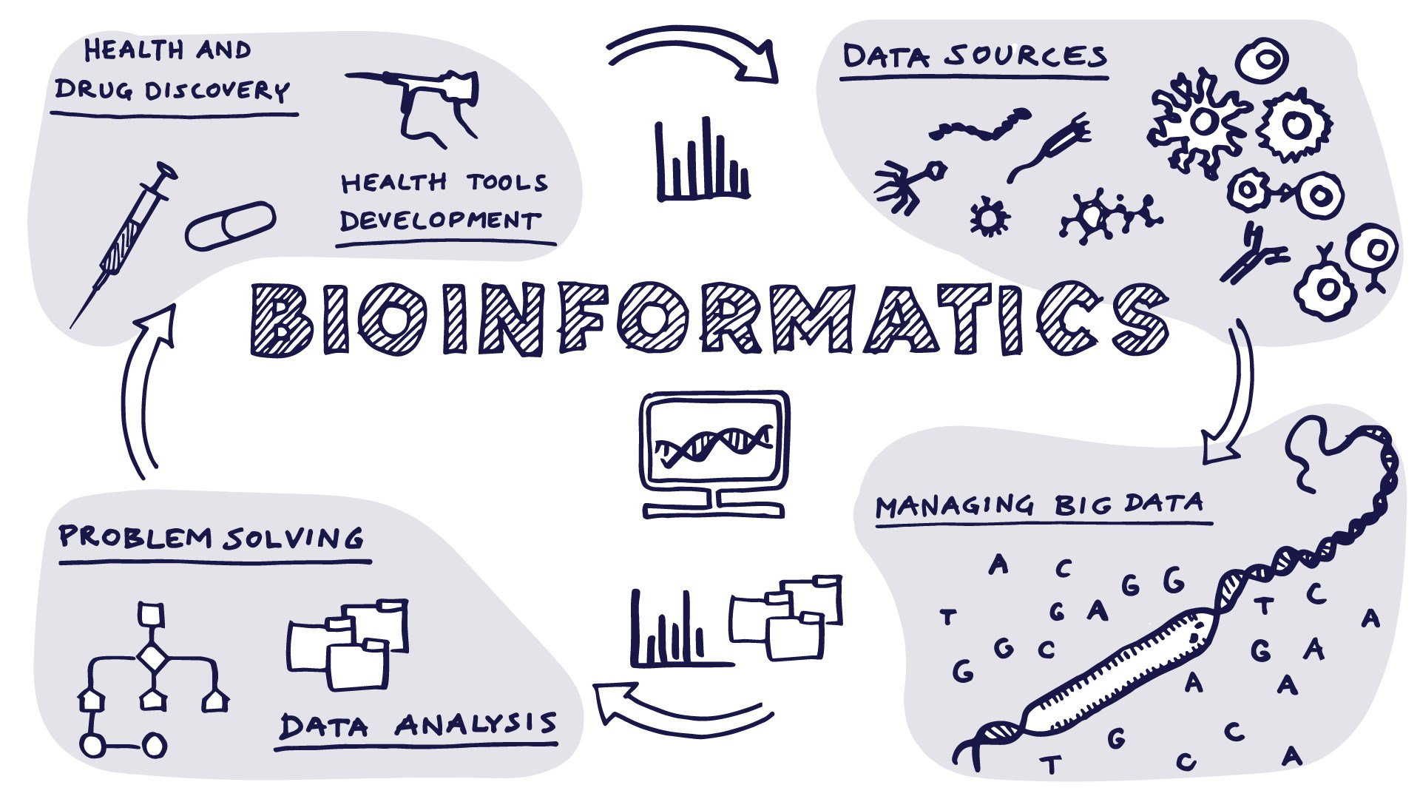
Stating the problem
Language Model Uncover Genome Relations
Introduction
Study area
Traditional techniques for DNA analysis are rapidly losing relevance.
The human genome is an immense repository of information, brimming with answers that demand exploration.
What outcomes arise when these questions are investigated using large language models?
Notes:
вводная как ии круто и что есть еще биология а что если соединить

Slide 3
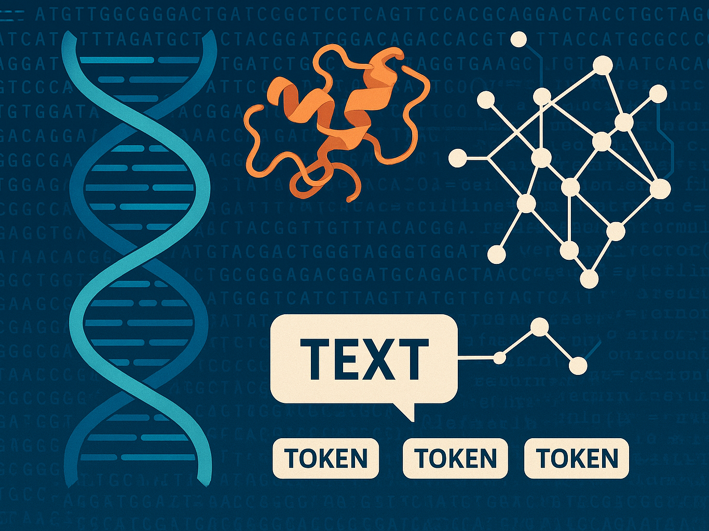
It is not just a coursework
Language Model Uncover Genome Relations
Introduction
Goals
Part of the HSE Bioinformatics Lab’s study on LLM interpretation of complex, rare DNA structures
Applied a novel LLM architecture to predict DNA secondary structures
Conducted experiments and leveraged xAI techniques to assess model performance
Compared model outputs against established biological insights
Delivered a methodological breakthrough to guide future bioinformatics research

Slide 4
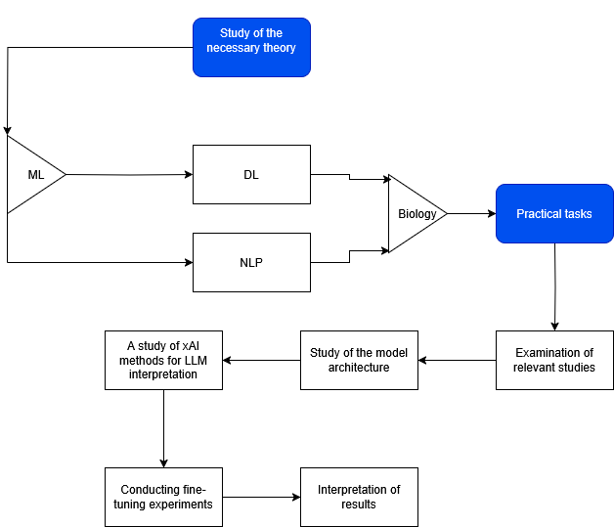
Formal objective
Language Model Uncover Genome Relations
Introduction
Goals
Tasks for the implementation of the research
Development of a large language model for predicting double helix structures and interpretation of its performance

Slide 5
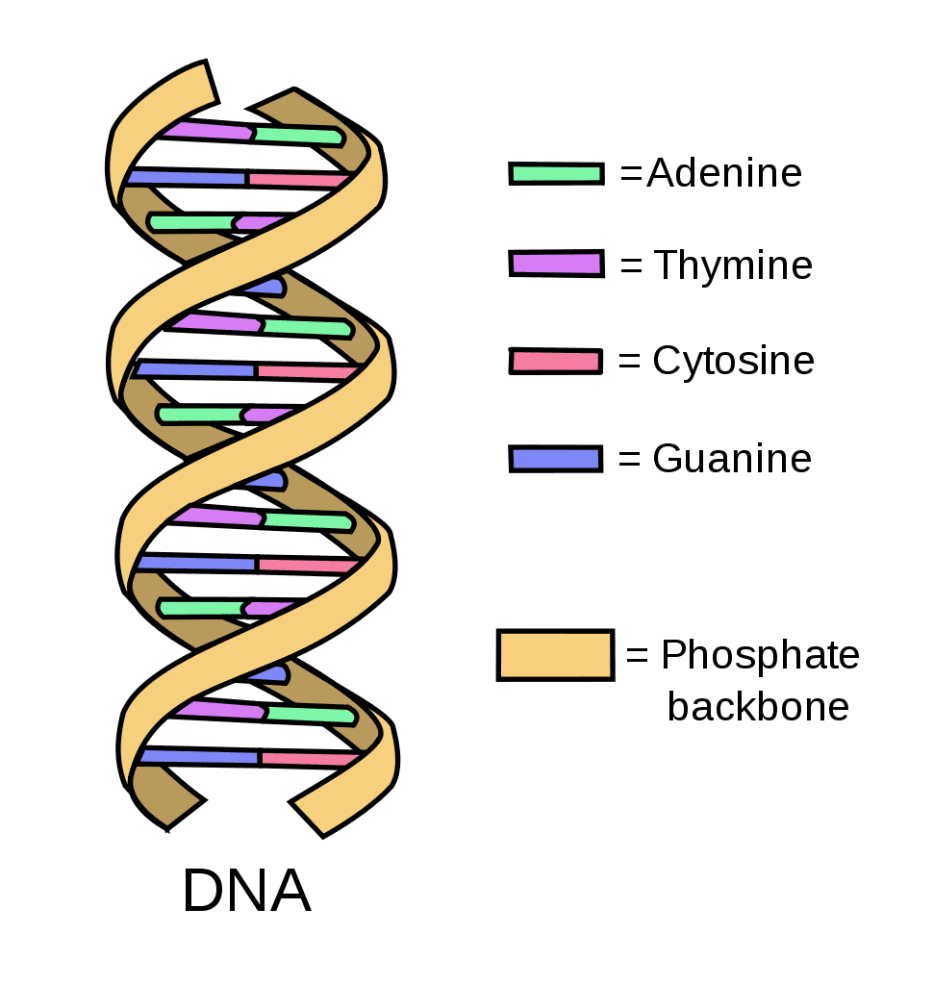
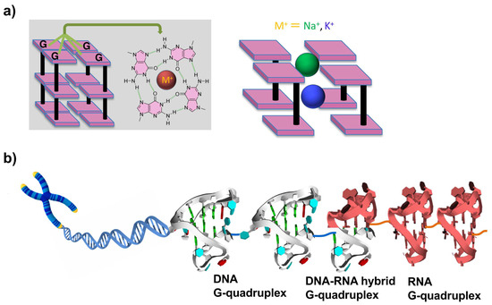
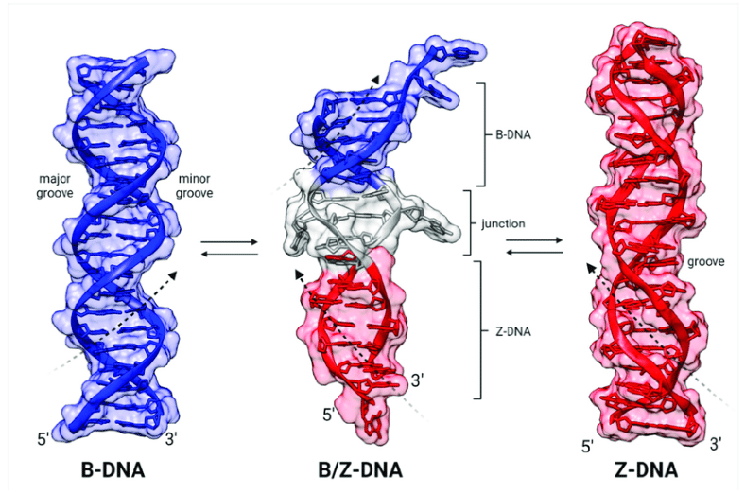
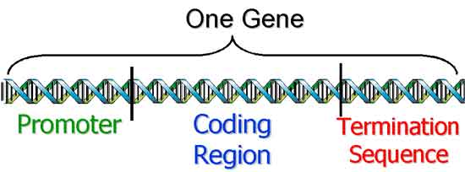
Language Model Uncover Genome Relations
Biology
Basics
Standard B-DNA: Right-handed double helix built from A, T, C, and G bases
Z-DNA: A left-handed helix that can form in alternating CG regions, often transient during active transcription.
G-quadruplexes (G4): Stacks of four guanines held together by metal ions (e.g., Na⁺ or K⁺), found in promoters and regulatory regions
Promoter: DNA segment where transcription begins.
Standart B-DNA
G4
Z-DNA
Promoter

Slide 6
Deoxyribonucleic acid (DNA)
Language Model Uncover Genome Relations
Biology
Basics
A macromolecule that carries the genetic information necessary for the development, function and reproduction of all known organisms and most viruses.
A sequence of length 3 billion
Each "line of code" in DNA is a nucleotide, and sets of four "letters" (A, T, G, C) form "operators" - a similar pair of characters in the code. The two DNA strands are twisted together as two version control branches that are always synchronised (A is always "paired" with T, G with C).
DNA is the human code, it describes the whole person.

Slide 7
Promoter
Language Model Uncover Genome Relations
Biology
Basics
It is a section of DNA to which RNA polymerase(reads the part of DNA to make it analysable) and transcription factors attach when transcription is initiated, providing the start of RNA synthesis. In other words it is a sign that coding region is close.
Without a promoter, the "compiler" (transcription complex) will not understand where in the source the necessary piece is located and from which place it is necessary to "start" copying.

Slide 8
Secondary DNA structures
Language Model Uncover Genome Relations
Biology
Basics
DNA double helix formed by complementary base pairing and base stacking
Includes the common right-handed B-helix
Alternative conformations: Z-helix (Z-DNA) and G-quadruplexes (G4)
Z-DNA (Z-helix)
Left-handed double helix forming in (CG)n regions with alternating bases
Can transiently switch between B-form and Z-form
Involved in transcription regulation, RNA-editing protein interactions, and innate immune responses
Linked to Alzheimer’s disease and being explored as a potential anticancer target
G-quadruplex (G4) structures Consist of four guanines stacking into a quadruplex helix
Frequently found in gene promoters, including oncogenes
Influence transcription factor binding to repress or activate gene expression
Stabilizing G4s is pursued as a strategy for novel drug development

Slide 9
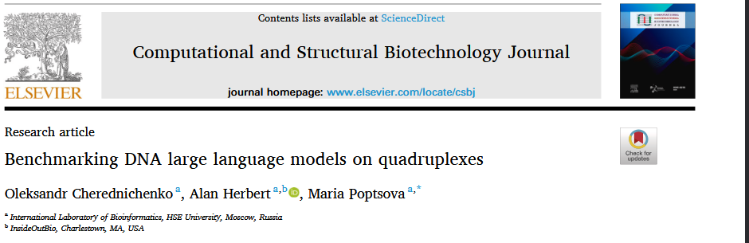
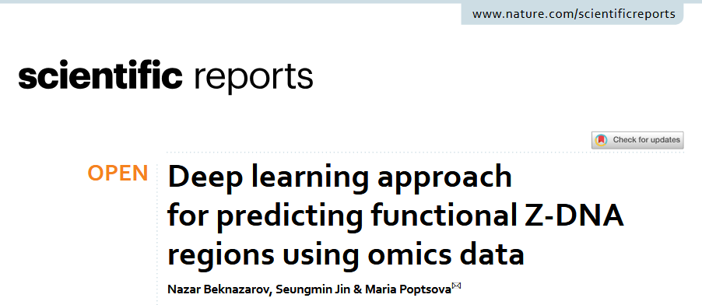
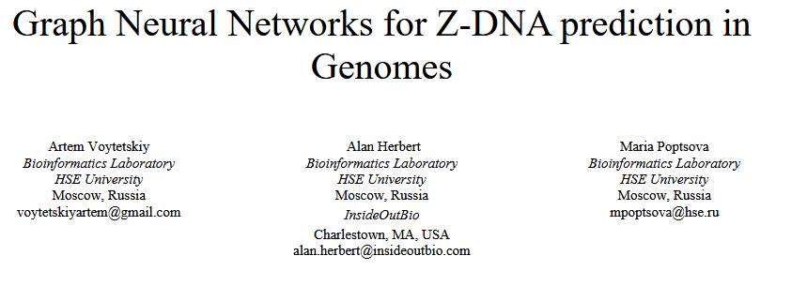
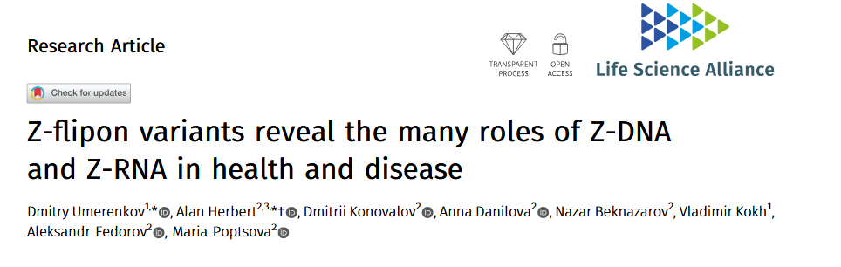
Relevant papers
Language Model Uncover Genome Relations
Literature overview
Existing DL approaches
DeepZ (Nazar Beknazarov, Seungmin Jin, Maria Poptsova, 2020) – RNN F1 = 0.40
GraphZ (Artem Voytetskiy, Alan Herbert, Maria Poptsova, 2022) – GNN F1 = 0.124
Z-DNABERT (Dmitry Umerenkov et al, 2023) – LLM Bert F1 = 0.83
Benchmarking DNA LLMs on G4 (Oleksandr Cherednichenko, Alan Herbert, Maria Poptsova, 2025) - LLM HyenaDNA F1 = 0.75

Slide 10
HumanGenome38 Kouzine et al
Genome Understanding Evaluation (GUE)
Language Model Uncover Genome Relations
Dataset and Methods
Dataset
Mapped single-stranded DNA in living cells using Kouzine et al. data.
Overlapped these regions with known G4 sites many matched, confirming G4 formation in cells.
Identified Z-DNA by locating unpaired T bases in Z-DNA prone sequences, marking B↔Z transitions.
The data covers ~ 41k regions.
GUE for promoter analysis.
A genome classification benchmark
Consists of ~60k regions
Notes:
Набор данных и цель
Использован hg38-выравненный датасет ssDNA-Seq (Kouzine et al.) для поиска нестандартных (не-B) форм ДНК в живых клетках.
Проверка G-квадруплексных (G4) сигналов
Пересекали пики ssDNA-Seq (данные из клеток) с высоконадежными G4-сайтами, полученными методом G4-Seq на «голой» человеческой ДНК (in vitro).
Выявили хорошее совпадение между пиками ssDNA и G4-мотивами, что подтверждает: многие ssDNA-сигналы действительно соответствуют свернутым G4-структурам в клетке.
Поиск участков Z-ДНК
Считаем участок Z-ДНК, если:
ssDNA-Seq фиксирует «свободные» (неспаренные) тимины,
эти тимины попадают внутрь последовательности, которую статистический алгоритм (например, Z-HUNT3) предсказывает способной перейти в Z-форму.
Модифицированные тимины указывают на точки B→Z-перехода, где правая спираль B-ДНК переходит в левую Z-ДНК.
Итог
Объединённые данные (KEx) позволяют точно определить и изучить, где в геноме человека в живых клетках образуются G4-структуры, Z-ДНК и другие вторичные конфигурации.

Slide 11
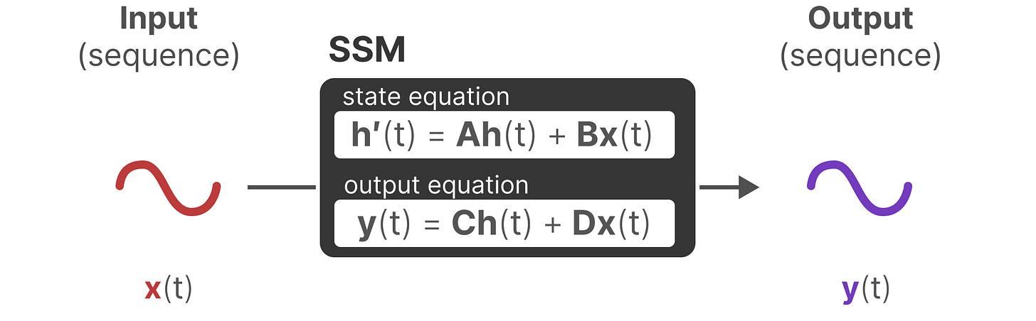
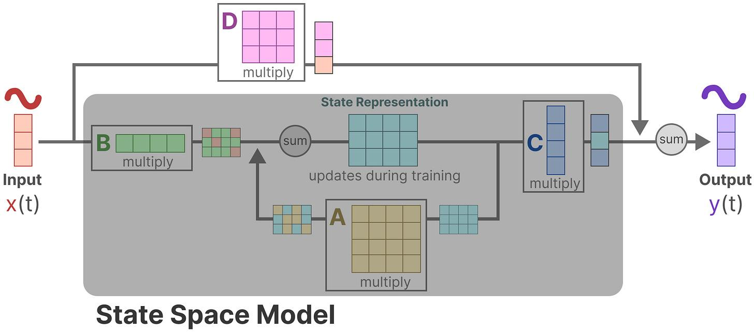
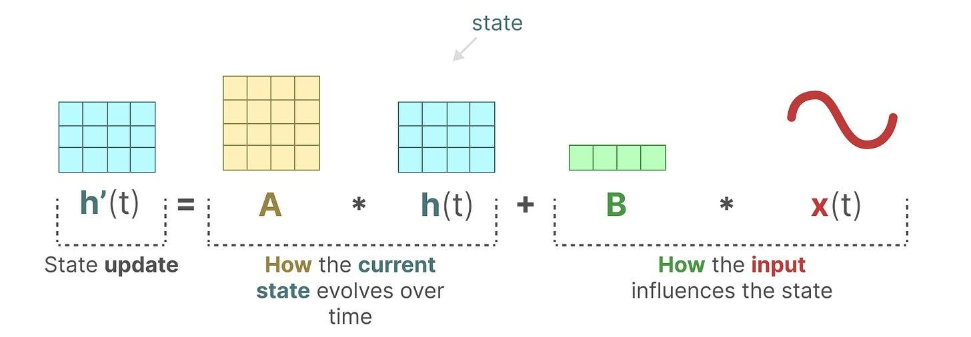
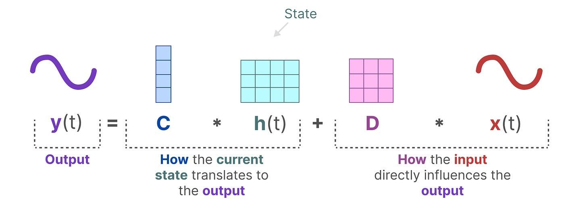
State Space Models
Language Model Uncover Genome Relations
Dataset and Methods
Methods
An SSM is like a smart memory box that gets updated with each new input in a fast, rolling way. No need to compare every past item to every other. Unlike self-attention, which looks at all pairs of positions, SSM simply carries forward a single state that already captures everything it’s seen, allowing it to handle extremely long sequences with far less computation.

Slide 12
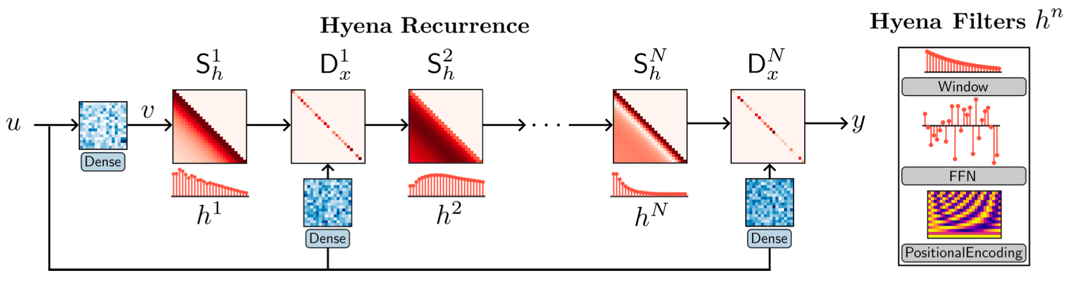
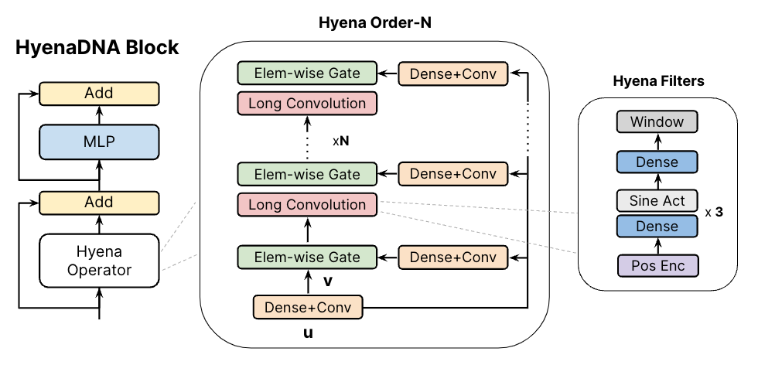
Hyena Operator
Language Model Uncover Genome Relations
Dataset and Methods
Methods
Hyena swaps the O(L²) attention step for implicit long convolutions plus element‐wise gating. It projects inputs into multiple streams, uses a small MLP to generate convolution filters on the fly, and applies FFT to compute convolutions in O(L log L) time. Gating then steers the information flow. Because filters are generated rather than stored, the parameter count stays fixed enabling efficient modeling of contexts up to ~1 million tokens without losing transformer‐level performance.

Slide 13
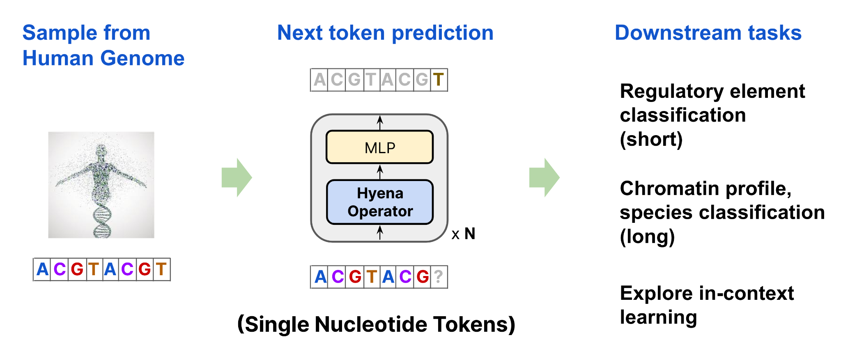
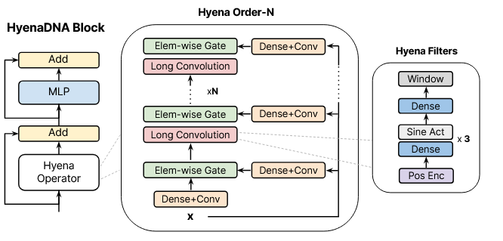
HyenaDNA
Language Model Uncover Genome Relations
Dataset and Methods
Methods
HyenaDNA, a decoder based foundation model for DNA analysis capable of processing sequences up to 1 million in length at the single character level, was chosen as the model.
Model pre-trained on the entire human reference genome
By combining these two new approaches, the authors have presented a variant of LLM that works for sub-quadratically complexity and having much less parameters.

Slide 14
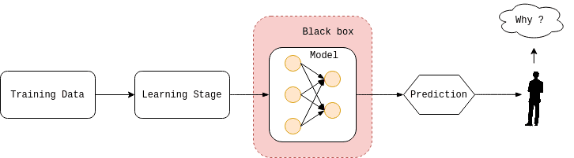
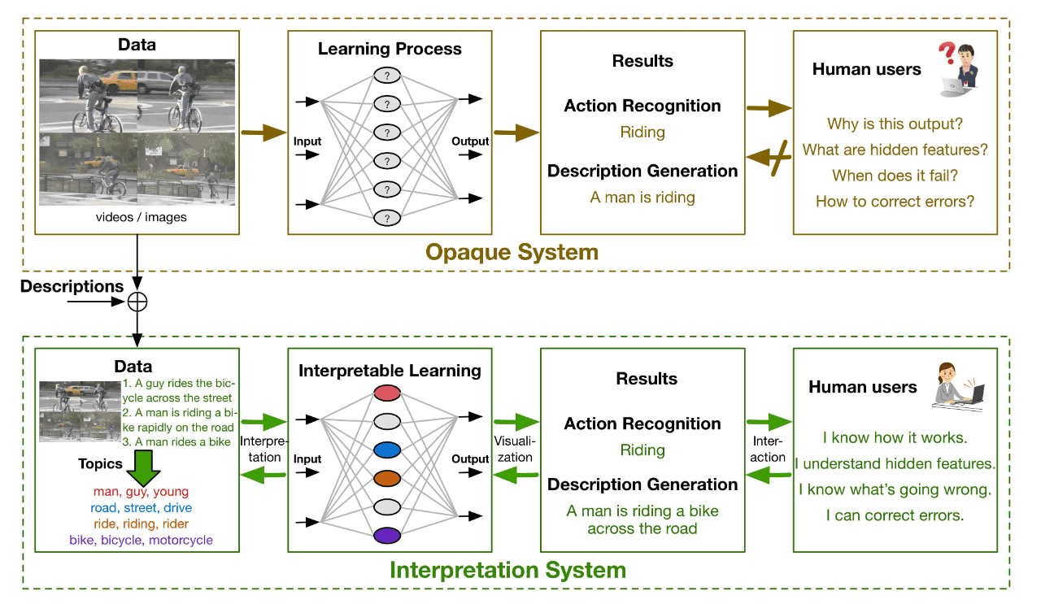
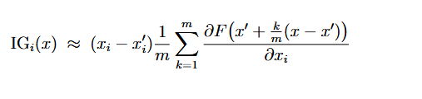
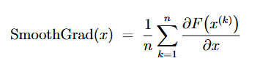
Explainable AI (xAI) or Interpretation
Language Model Uncover Genome Relations
Dataset and Methods
Methods
Interpretability describes how clearly we can see why an algorithm made a particular decision.
Aims to open the “black box” of complex models so we can see why they make certain decisions.
Compute how the output changes when you tweak each input slightly, highlighting key features.
Builds user confidence by showing “what the model looked at” when making a prediction.
Notes:
Informally, the difference between the two methods is that IG will show exactly how each
token affected the predictions from the null vector to the vector with real values, while SmoothGrad
removes random bursts of tokens by generating n noisy copies of embeddings with real values and
counting the gradient over them, which is then averaged.

Slide 15
Integrated Gradients
SmoothGrad
Language Model Uncover Genome Relations
Dataset and Methods
Methods
Assigns each input feature a contribution score by accumulating the model’s gradients along a straight-line path from a baseline input x' (often all zeros) to the actual input x.
In practice, this integral is approximated by summing over m steps.
Reduces noise in gradient-based saliency maps by averaging over many noisy samples of the input. Given n noisy copies x^k = x + Normal, the final attribution is calculated by the formula
By adding Gaussian noise to embeddings or to the raw input, and then averaging the resulting gradient maps, SmoothGrad highlights consistent attribution patterns and smooths out unexpected peaks.
Notes:
Informally, the difference between the two methods is that IG will show exactly how each
token affected the predictions from the null vector to the vector with real values, while SmoothGrad
removes random bursts of tokens by generating n noisy copies of embeddings with real values and
counting the gradient over them, which is then averaged.

Slide 16
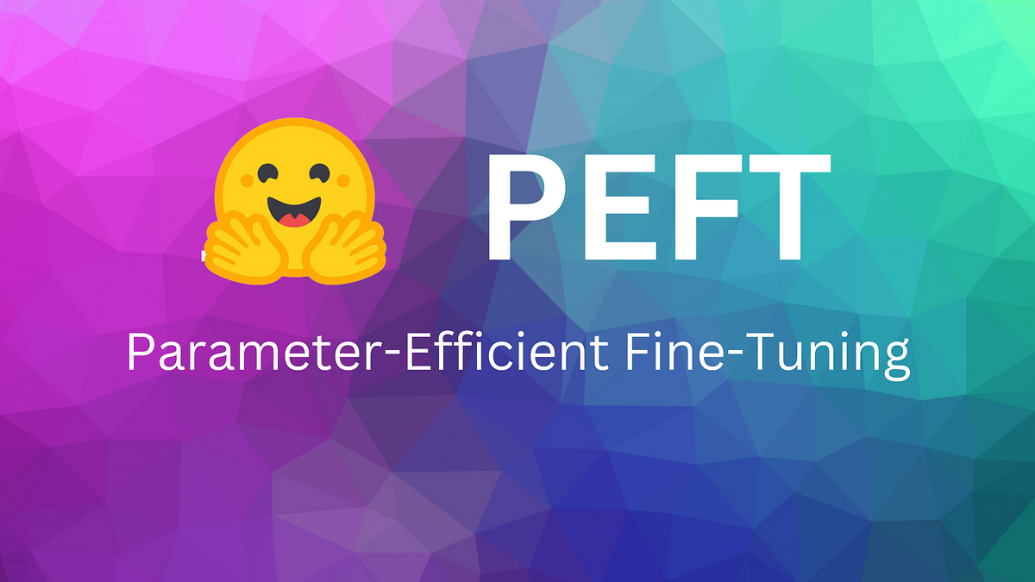
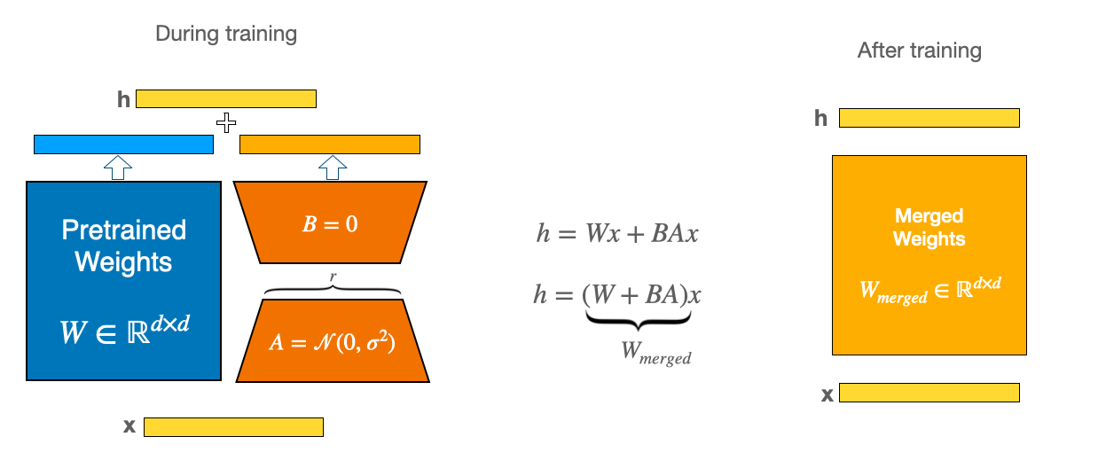
Low-Rank Adaptation (LoRA)
Language Model Uncover Genome Relations
Dataset and Methods
Methods
LoRA is a common PEFT method for fine-tune large models cheaply by adding and learning only low-rank adapters.
LoRA keeps the original pretrained weight matrix W frozen and learns two small low-rank matrices A and B.
During fine-tuning, only A and B are updated, drastically reducing the number of trainable parameters, and at inference time the low-rank update is merged into W for standard usage.

Slide 17
Low-Rank Adaptation (LoRA)
Language Model Uncover Genome Relations
Dataset and Methods
Methods
LoRA makes fine-tuning large pretrained models faster and lighter by keeping the original weight matrix frozen and learning only a small, low-rank update.
Express the update ∆W to the frozen weight matrix W as the product of two much smaller matrices A B.
A and B capture the task-specific changes without touching W itself.
Then form the adapted weight matrix W ′ by adding the update: W ′ = W + ∆W. W stays exactly as it was pretrained, and ∆W carries all the fine-tuning.
When the layer sees an input x ∈ R^k, it computes
y = W ′ x = W x + A (Bx).
Since r (rank A and B) is much smaller than d and k, training costs drop from O(dk) to O((d + k)*r)

Slide 18
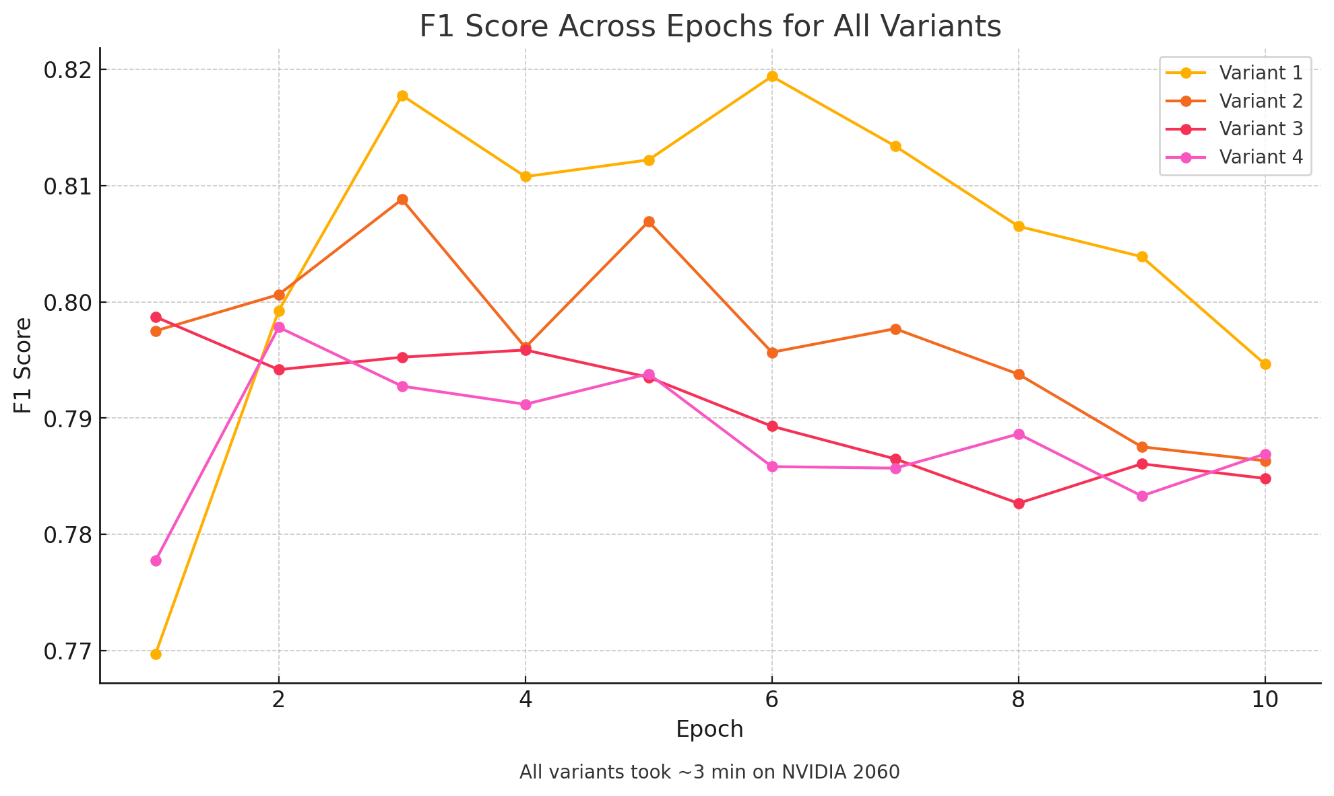
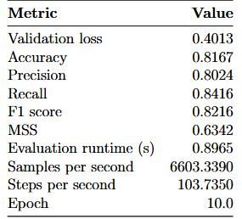
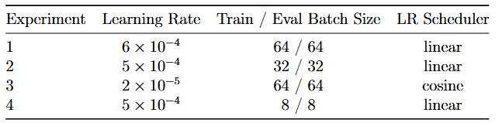
Standard fine-tuning
Language Model Uncover Genome Relations
Experimental Evaluation
Promoters
The data from GUE was stored as follows: sequences of length 70, labeled 1 if the sequence is a promoter and 0 otherwise, so it is a sequence classification task.
As a result, the best performance ended up being the settings of the first experiment. F1 = 0.82
Hyperparameter settings for the four HyenaDNA training runs. All experiments used 10 epochs, warmup ratio 0.1, weight decay 0.01, the adamw_torch optimizer, and FP16 precision

Slide 19
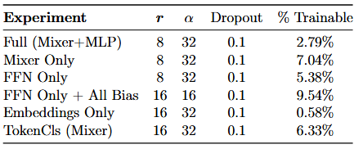
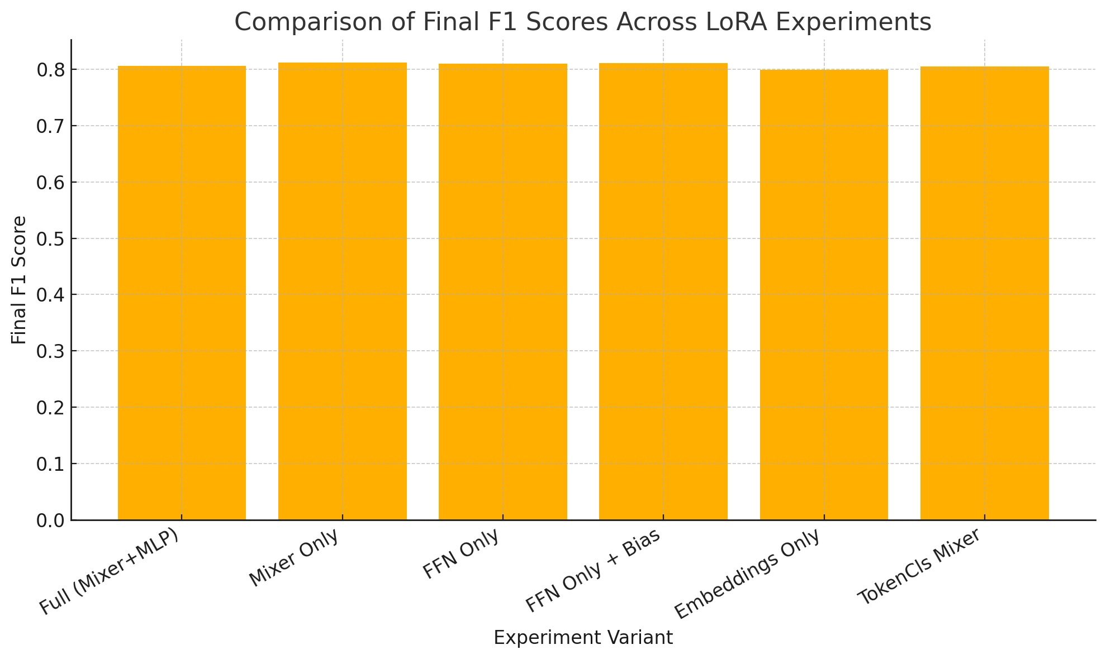
LoRA
Language Model Uncover Genome Relations
Experimental Evaluation
Promoters
As a result, LoRA did not bring any advantage in the task of promoters on the HyenaDNA model, time required is the same and F1 = 0.81
LoRA configuration for each experiment: rank r, α, dropout, and percentage of trainable parameters.

Slide 20
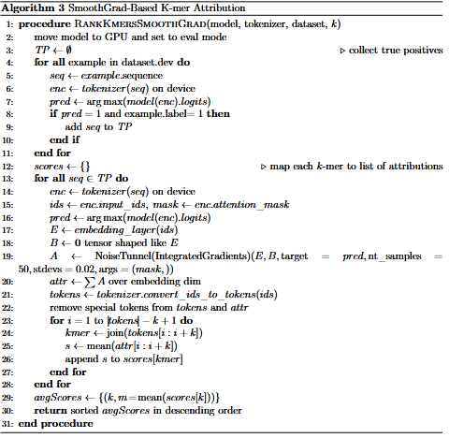
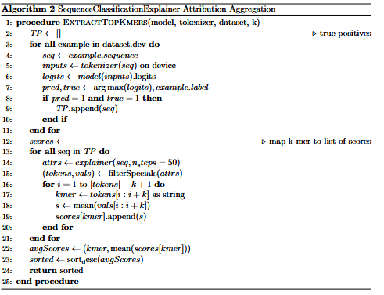
Interpretation
Language Model Uncover Genome Relations
Experimental Evaluation
Promoters

Slide 21
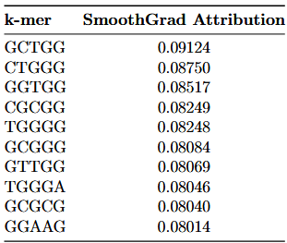
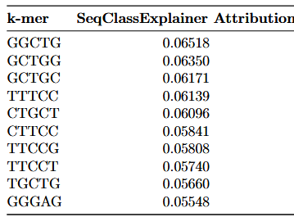
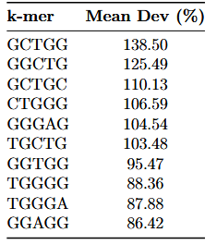
Interpretation
Language Model Uncover Genome Relations
Experimental Evaluation
Promoters
For interpretation I used weights of the model with the best F1 (0.82)
In summary, the two methods of interpretation and their ranking showed that G and C combinations are in the top, which is consistent with the biological promoter theory, and most importantly shows that the model was able to identify the correct dependencies.
Top 10 5-mers by average SmoothGrad attribution score
Top 10 5-mers by average IG attribution score
Consensus ranking of top 5-mers by average percent deviation from mean attributions
across Integrated Gradients and SmoothGrad

Slide 22
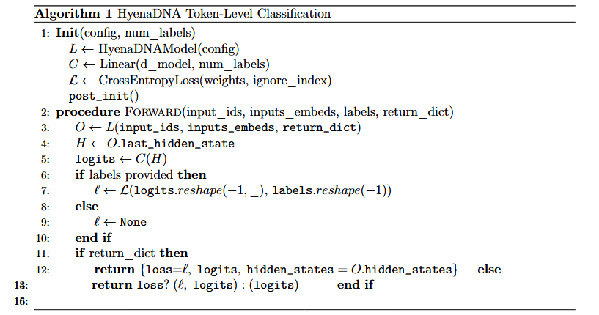
Model’s Details
Language Model Uncover Genome Relations
Experimental Evaluation
Z-DNA
Positive examples are one-quarter as frequent as negatives, so all train/val/test splits use stratified sampling to maintain the 1:3 class ratio.
The pretrained HyenaDNA model lacks a token-classification head, so a new class, HyenaDNAForTokenClassification, was created extending HyenaDNAPreTrainedModel
Read num_labels from either keyword arguments or configuration.
Instantiate the HyenaDNA backbone via HyenaDNAModel(config). Attach a linear classifier of shape (d_model × num_labels) without bias.
Set up cross-entropy loss with class weights (tuned experimentally) and ignore_index = -100 to skip special tokens.
Methods get_input_embeddings / set_input_embeddings expose the embedding layer for external modifications.
Returns a TokenClassifierOutput containing loss, logits, and optional hidden states, or a (loss, logits) tuple if return_dict=False

Slide 23
Details
Language Model Uncover Genome Relations
Experimental Evaluation
Z-DNA
Positive examples are one-quarter as frequent as negatives, so all train/val/test splits use stratified sampling to maintain the 1:3 class ratio.
The pretrained HyenaDNA model lacks a token-classification head, so a new class, HyenaDNAForTokenClassification, was created extending HyenaDNAPreTrainedModel

Slide 24
Standart Fine-Tuning: Best Approach
Language Model Uncover Genome Relations
Experimental Evaluation
Z-DNA
Through extensive Z-DNA experiments, the most effective setup was freezing both the model’s head and body, yielding an F1 0.64 , and an MCC 0.62.
The best performance was obtained with a custom two-phase training regimen under the following settings: class-weighted cross-entropy loss with weights w− = 0.7 (negative) and w+ = 2.0; sequence length L = 100; batch size 64; no data augmentation; standard HyenaDNA tokenization; stratified 60/20/20 train/val/test split.
Phase 1: Frozen Backbone. Only the classification head was trained for 3 epochs at learning rate η = 10−3, while all Hyena backbone parameters remained frozen. This allowed the newly-initialized head to specialize rapidly without perturbing pretrained features.
Phase 2: Full Fine-Tuning. The entire model was unfrozen and trained for 6 further epochs with discriminative learning rates: ηbackbone = 10−5 and ηhead = 5 × 10−4. This produced the final F1 score of 0.64 on the evaluation set.

Slide 25
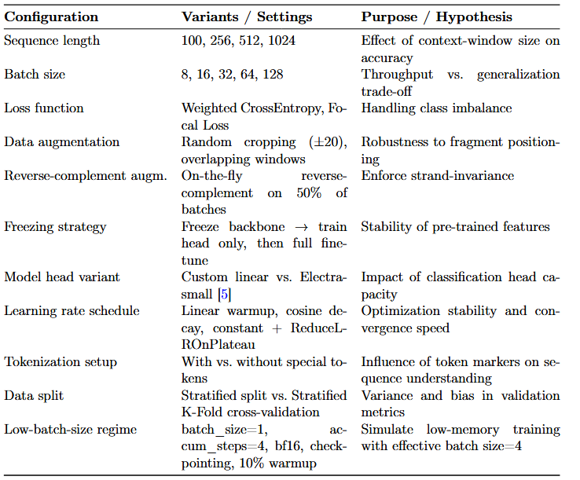
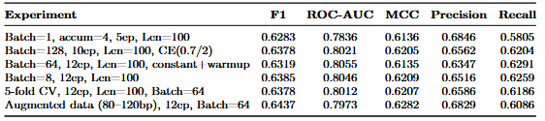
Standart Fine-Tuning: Another Approaches
Language Model Uncover Genome Relations
Experimental Evaluation
Z-DNA
Comparison of evaluation metrics across various training configurations near the optimal
solution

Slide 26
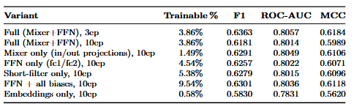
LoRA
Language Model Uncover Genome Relations
Experimental Evaluation
Z-DNA
The LoRa situation on the Z-DNA task is very similar to the outcome of the promoters’task.
LoRa once again did not provide any significant speedup, and its performance metrics were almost the same as with standard fine-tuning

Slide 27
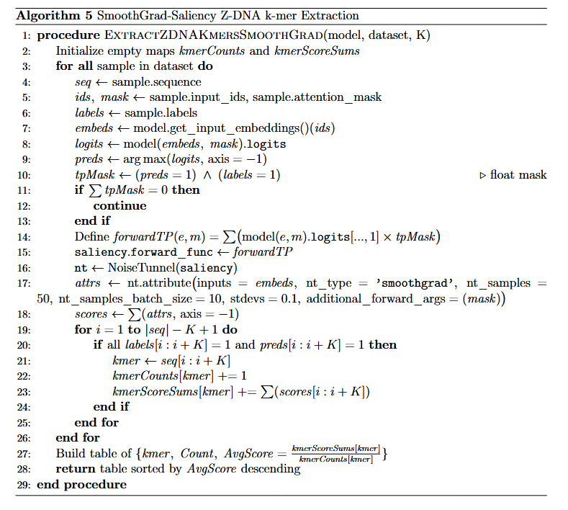
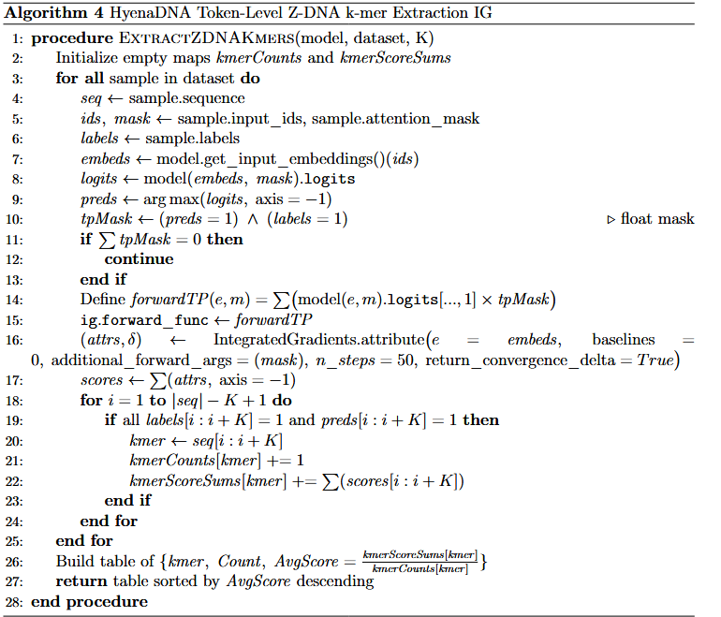
Interpretation
Language Model Uncover Genome Relations
Experimental Evaluation
Z-DNA

Slide 28
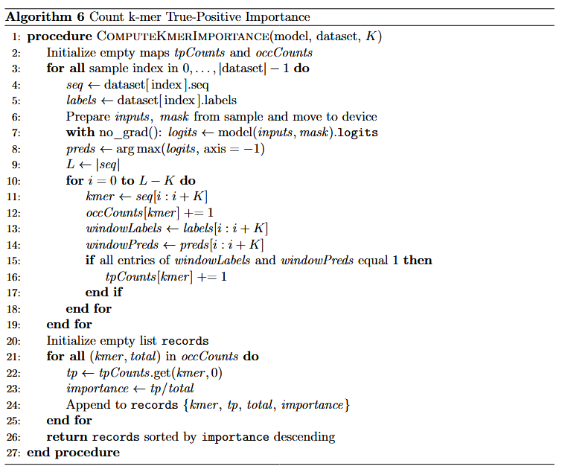
Interpretation
Language Model Uncover Genome Relations
Experimental Evaluation
Z-DNA
Count k-mer True-Positive Importance algorithm is not a gradient-based interpretation method, but rather an idea that can be used to augment complete solutions.
To get a quick, model-agnostic importance score, I simply computed, for each token, the fractionTP occurrences / Total occurrences over the set (also TP only).
Note that “TP / Total” score only captures tokens inside annotated Z-DNA regions

Slide 29
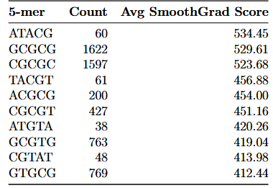
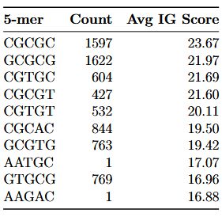
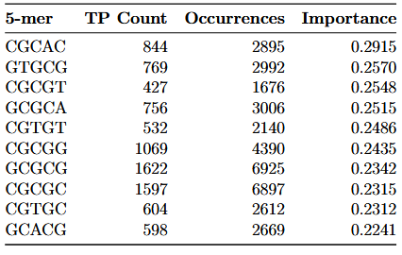
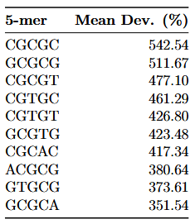
Interpretation
Language Model Uncover Genome Relations
Experimental Evaluation
Z-DNA
For interpretation I used weights of the model with the best F1 (0.64)
In summary, interpretation analyses of IG, SmoothGrad and TP k-mer counting have all independently identified GC-rich 5-mers such as CGCGC, GCGCG and CGCGT as the most influential motifs for Z-DNA prediction. This result is consistent with the biological theory of Z-DNA, which states that the alternation of such nucleotides occurs in regions of the left-handed helix.
Top 10 5-mers by average SmoothGrad attribution score
Top 10 5-mers by average IG attribution score
Consensus ranking of top 5-mers by average percent deviation from mean attributions
across Integrated Gradients and SmoothGrad
Top 10 5-mers ranked by True-Positive importance: the fraction of times each 5-mer
was predicted correctly among its total occurrences.

Slide 30
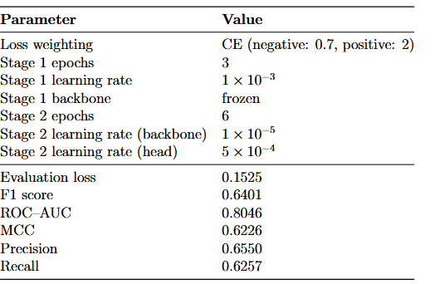
Z-DNA conclusion
Language Model Uncover Genome Relations
Experimental Evaluation
Z-DNA
Outperformed DeepZ and GraphZ even without using omics features.
Did not exceed Z-DNABERT’s F1 score of 0.83, confirming that Transformer models still lead in raw accuracy.
HyenaDNA trains dramatically faster than Transformer-based approaches
Uses strict token-level labeling for Z-DNA regions, offering a more rigorous benchmark than previous studies.
Despite lower overall accuracy, the top-ranked 5-mer from attribution matches known biologically validated motifs, showing the model has learned meaningful signals.
Two-stage fine-tuning setup and resulting test metrics for the best model.

Slide 31
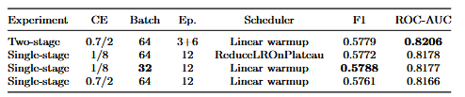
Standard fine-tuning
Language Model Uncover Genome Relations
Experimental Evaluation
G4
After running numerous experiments, it became clear that the model, regardless of hyperparameter settings, quickly reaches a performance plateau indicating its limited capacity for further improvement on this task.
The best result, however, was achieved with standard training using a batch size of 32, sequence length of 100, 10 percent warmup, class-weighted cross-entropy loss (CE = 1 and 8), and 12 epochs, yielding an F1 0.5788.
Comparison of G4-classification setups.

Slide 32
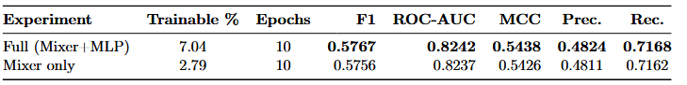
LoRA and results for G4
Language Model Uncover Genome Relations
Experimental Evaluation
G4
In the end LoRa showed the same trend as in the previous experiments, no significant code acceleration, but metrics almost like a regular fine-tune. LoRa once again proved unnecessary for the HyenaDNA architecture.
G4 prediction proved to be the weakest link in this study, with metrics too low to warrant deeper interpretation. By comparison, a recent benchmark of HyenaDNA achieved an F1 0.75 roughly 20 points higher when training from scratch.
Although differences in pre-training strategies make direct comparison unfair, it is still instructive to note that Transformer-based models adapt far more effectively to G4 classification.
In other words, for DNA G4 secondary-structure prediction, HyenaDNA falls short of its alternatives.
Comparison of LoRA-finetuned HyenaDNA variants on the G4 token-classification task. The “Full” variant adapts both mixer and MLP layers, while “Mixer only” adapts mixer layers alone. Metrics taken at the final epoch (10). Best values in bold.

Slide 33
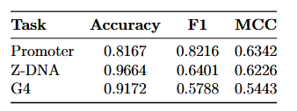
HyenaDNA results
Language Model Uncover Genome Relations
Conclusion
HyenaDNA
HyenaDNA, fine-tuned on promoter data, identified promoter segments.
Achieved good performance across all promoter categories with significantly lower training time.
Outperformed both DeepZ and GraphZ in quality metrics, despite using only sequence data (no omics features).
Did not surpass Z-DNABERT’s F1 of 0.83, but training and inference were substantially faster.
Attribution analyses ranked the known 5-mer motif highest, confirming correct biological signal learning.
HyenaDNA’s fine-tuned models for G4 scored lowest among the three tasks
Across tasks, HyenaDNA often approached good results while reducing training time dramatically comparing to transformers.
Demonstrated strong signal localization (especially in Z-DNA), even in cases of lower raw accuracy.
Resulting best metrics for each task

Slide 34


Goals
Language Model Uncover Genome Relations
Conclusion
Future plans
Continue exploring HyenaDNA’s architecture beyond classical fine-tuning, including training from scratch and integrating multi-omics data.
Continue work with the International Laboratory of Bioinformatics to refine LLM approaches for DNA secondary-structure prediction.
Expand pretraining objectives and data regimes to better tailor HyenaDNA to genomics-specific patterns.
Aim to publish refined methodologies and benchmark results in a top-tier bioinformatics journal.

Slide 36
References
Language Model Uncover Genome Relations
References
Papers
Pierce, Benjamin A. Genetics: A Conceptual Approach. W. H. Freeman, 2017. ISBN 978-1-319-72085-3.
Bartas, Martin; Slychko, Kristyna; Cerven, Jiri; Pecinka, Petr; Arndt-Jovin, Donna J.; Jovin, Thomas M. “Extensive Bioinformatics Analyses Reveal a Phylogenetically Conserved Winged Helix (WH) Domain (Zτ) of Topoisomerase IIα, Elucidating Its Very High Affinity for Left-Handed Z-DNA and Suggesting Novel Putative Functions.” International Journal of Molecular Sciences, 2023.
Cherednichenko, O.; Herbert, A.; Poptsova, M. “Benchmarking DNA Large Language Models on Quadruplexes.” Computational and Structural Biotechnology Journal, Vol. 27, 2025, pp. 992–1000. doi:10.1016/j.csbj.2025.03.007.
Clark, Kevin; Luong, Minh-Thang; Le, Quoc V.; Manning, Christopher D. “ELECTRA: Pre-training Text Encoders as Discriminators Rather Than Generators.” arXiv preprint arXiv:2003.10555, 2020. Proceedings of ICLR 2020. doi:10.48550/arXiv.2003.10555.
Fishman, Veniamin; Kuratov, Yuri; Shmelev, Aleksei; Petrov, Maxim; Penzar, Dmitry; Shepelin, Denis; Chekanov, Nikolay; Kardymon, Olga; Burtsev, Mikhail. “GENA-LM: A Family of Open-Source Foundational DNA Language Models for Long Sequences.” Nucleic Acids Research, 2025. Gu, Albert; Goel, Karan; Ré, Christopher. “Efficiently Modeling Long Sequences with Structured State Spaces.” arXiv preprint arXiv:2111.00396, 2021.
Hu, Edward J.; Shen, Yelong; Wallis, Phillip; Allen-Zhu, Zeyuan; Li, Yuanzhi; Wang, Shean; Wang, Lu; Chen, Weizhu. “LoRA: Low-Rank Adaptation of Large Language Models.” arXiv preprint arXiv:2106.09685, 2021. https://doi.org/10.48550/arXiv.2106.09685.
Kouzine, F.; Wojtowicz, D.; Baranello, L.; Yamane, A.; Nelson, S.; Resch, W.; Kieffer-Kwon, K.-R.; Benham, C. J.; Casellas, R.; Przytycka, T. M.; Levens, D. “Permanganate/S1 Nuclease Footprinting Reveals Non-B DNA Structures with Regulatory Potential Across a Mammalian Genome.” Cell Systems, Vol. 4, No. 3, 2017.
Beknazarov, Nazar; Konovalov, Dmitrii; Herbert, Alan; Poptsova, Maria. “Z-DNA Formation in Promoters Conserved Between Human and Mouse Are Associated with Increased Transcription Reinitiation Rates.” Scientific Reports, Vol. 14, 2024, Article 17786.
Beknazarov, Nazar; Jin, Sheng; Poptsova, Maria. “Deep Learning Approach for Predicting Functional Z-DNA Regions Using Omics Data.” Scientific Reports, vol. 10, Article 19134, 2020. https://doi.org/10.1038/s41598-020-76203-1.
Kosiol, Natalie; Juranek, Silke; Brossart, Peter; Heine, Andreas; Paeschke, Klaus. “G-Quadruplexes: A Promising Target for Cancer Therapy.” Molecular Cancer, vol. 20, no. 1, Article 40, 25 Feb. 2021. https://doi.org/10.1186/s12943-021-01328-4. PMID: 33632214; PMCID: PMC7905668.
Nguyen, Eric; Poli, Michael; Faizi, Marjan; Thomas, Armin; Birch-Sykes, Callum; Wornow, Michael; Patel, Aman; Rabideau, Clayton; Massaroli, Stefano; Ermon, Stefano; Bengio, Yoshua; Baccus, Stephen A.; Ré, Christopher. “HyenaDNA: Long-Range Genomic Sequence Modeling at Single Nucleotide Resolution.” arXiv preprint arXiv:2306.15794 [cs.LG], 2023.
Poli, Michael; Massaroli, Stefano; Nguyen, Eric; Fu, Daniel Y.; Dao, Tri; Baccus, Stephen; Bengio, Yoshua; Ermon, Stefano; Ré, Christopher. “Hyena Hierarchy: Towards Larger Convolutional Language Models.” In: Krause, Andreas; Brunskill, Emma; Cho, Kyunghyun; Engelhardt, Barbara; Sabato, Sivan; Scarlett, Jonathan, eds. Proceedings of the 40th International Conference on Machine Learning. Vol. 202, Proceedings of Machine Learning Research, PMLR, 2023, pp. 28043–28078. https://proceedings.mlr.press/v202/poli23a.html.
Schiff, Yair; Kao, Chia-Hsiang; Gokaslan, Aaron; Dao, Tri; Gu, Albert; Kuleshov, Volodymyr. “Caduceus: Bi-Directional Equivariant Long-Range DNA Sequence Modeling.” arXiv preprint arXiv:2403.03234v2 [q-bio.GN], 2024.
Smilkov, Daniel; Thorat, Nikhil; Kim, Been; Viégas, Fernanda; Wattenberg, Martin. “SmoothGrad: Removing Noise by Adding Noise.” arXiv preprint arXiv:1706.03825, 2017. https://doi.org/10.48550/arXiv.1706.03825.
Sundararajan, Mukund; Taly, Ankur; Yan, Qiqi. “Axiomatic Attribution for Deep Networks.” In: Proceedings of the International Conference on Machine Learning, PMLR, 2017, pp. 3319–3328.
Umerenkov, Dmitry; Herbert, Alan; Konovalov, Dmitrii; Danilova, Anna; Beknazarov, Nazar; Kokh, Vladimir; Fedorov, Aleksandr; Poptsova, Maria. “Z-Flipon Variants Reveal the Many Roles of Z-DNA and Z-RNA in Health and Disease.” bioRxiv, 2023. https://doi.org/10.1101/2023.01.12.523822.
Varshney, Jonathan; Spiegel, David; Zyner, Kristopher; Tannahill, David; Balasubramanian, Shankar. “The Regulation and Functions of DNA and RNA G-Quadruplexes.” Nature Reviews Molecular Cell Biology, vol. 21, pp. 459–474, 2020. https://doi.org/10.1038/s41580-020-0236-x.
Vasudevaraju, P.; Bharathi; Garruto, R. M.; Sambamurti, K.; Rao, K. S. J. “Role of DNA Dynamics in Alzheimer’s Disease.” Brain Research Reviews, vol. 58, no. 1, pp. 136–148, 2008. https://doi.org/10.1016/j.brainresrev.2008.01.001.

Slide 37
References
Language Model Uncover Genome Relations
References
Papers
Vaswani, Ashish; Shazeer, Noam; Parmar, Niki; Uszkoreit, Jakob; Jones, Llion; Gomez, Aidan N.; Kaiser, Łukasz; Polosukhin, Illia. “Attention Is All You Need.” In Advances in Neural Information Processing Systems, vol. 30, 2017, pp. 5998–6008.
Voytetskiy, Artem; Herbert, Alan; Poptsova, Maria. “Graph Neural Networks for Z-DNA Prediction in Genomes.” IEEE, 2022. DOI: 10.1101/2022.08.23.504929.
Wang, A. J.; Quigley, G.; Kolpak, F.; et al. “Molecular Structure of a Left-Handed Double Helical DNA Fragment at Atomic Resolution.” Nature, vol. 282, 1979, pp. 680–686. https://doi.org/10.1038/282680a0
Xu, Yan; Komiyama, Makoto. “G-Quadruplexes in Human Telomere: Structures, Properties, and Applications.” Molecules, vol. 29, no. 1, 2024. ISSN 1420-3049. doi: 10.3390/molecules29010174. URL: https://www.mdpi.com/1420-3049/29/1/174
Zeng, Rong; Li, Zhi; Li, Jia; Zhang, Qing. “DNA Promoter Task-Oriented Dictionary Mining and Prediction Model Based on Natural Language Technology.” Scientific Reports, vol. 15, no. 1, Jan. 2025, p. 153. doi: 10.1038/s41598-024-84105-9
Zhang, Ting; Yin, Chaoran; Fedorov, Aleksandr; Qiao, Liangjun; Bao, Hongliang; Beknazarov, Nazar; Wang, Shiyu; Gautam, Avishekh; Williams, Riley M.; Crawford, Jeremy Chase; et al. “Z-DNA Secondary Structure Conforms to a Unique Conformation In Vivo and Affects Transcription and Chromatin Structure.” Nature, vol. 606, no. 7914, 2022, pp. 594–602. doi: 10.1038/s41586-022-04753-7
Zhou, Zhihan; Ji, Yanrong; Li, Weijian; Dutta, Pratik; Davuluri, Ramana; Liu, Han. “DNABERT-2: Efficient Foundation Model and Benchmark for Multi-Species Genome.” arXiv preprint arXiv:2306.15006 [q-bio.GN], 2023.

